Slide 1

Vaccination management system.
TOPIC:

Slide 2
Group members :-
Kashyap maisuria (196370307025)
Rohan patil (196370307055)
Ved panchal (196370307033)
Rishi naik (196370307030)
GUIDED BY:
- MRS. P.P.VAGHASHIA

Slide 3
Description:
This website is for people to get vaccine and fight against COVID.
Vaccination is the administration of a vaccine to help the immune system develop protection from a disease.
a digital platform, was created for real-time monitoring of vaccine delivery.
You can easily be vaccinated just by providing your basic details.
Through this system vaccine can distributed in proper manner without any wastage of any single dose.

Slide 4
you'll have provide it's details to Vaccinator while going for Vaccination.
Vaccination management system is the digital back bone for the vaccination drive in India With scaling up of vaccination.
the number of vaccination facilities and sessions has to be increased and managed effectively.
the number of vaccination facilities and sessions has to be increased and managed effectively.
Our primary Services are:-
Slot Booking
Select vaccination center in own area
Support/FAQ for any problem
Certificate

Slide 5
Tools & Technology
Software Specification: -
Front – end Tool:- Visual studio 2019, Sublime Text.
Design and markup languages like HTML, CSS.
User friendly.
Low cost Solution.
Easy to debugging.
Back-end Tool:- Xampp MySQL 8.0. 21
Programming and scripting languages like PHP.
Security.
Portability.
Database management and data transformation.

Slide 6
Project modules :
This website contain different types of modules :-
Registration/Login
Home page
Dashboard
Admin
Vaccination Center
Slots
Help
Feedback

Slide 7
TABLE SPECIFICATION
1 .TABLE :- User
COLUMN NAME | DATA TYPE (SIZE) | CONSTRAINT
ID | NUMBERIC | PRIMARY KEY
USER_NAME | VARCHAR | -
USER_EMAIL | VARCHAR | -
USER_PASSWORD | VARCHAR | -
ROLL | VARCHAR | -
CITY | INT | -
STATE | INT | -

Slide 8
2 .TABLE :- Sub User
COLUMN NAME | DATA TYPE (SIZE) | CONSTRAINT
USER_ID | NUMBERIC | FOREGIN KEY
SUB USER_ID | NUMBERIC | PRIMARY KEY
STATUS | CHAR
DOSE | VARCHAR
NAME | CHAR
GENDER | NUMBERIC
ID_PROOF | VARCHAR
VACCINE_NAME | VARCHAR

Slide 9
3 .TABLE :- State
COLUMN NAME | DATA TYPE (SIZE) | CONSTRAINT
STATE_ID | NUMBERIC | PRIMARY KEY
STATE_NAME | NUMBERIC

Slide 10
4 .TABLE :- City
COLUMN NAME | DATA TYPE (SIZE) | CONSTRAINT
CITY_ID | NUMBERIC | PRIMARY KEY
CITY_NAME | VARCHAR | -
STATE_ID | NUMBERIC | FOREGIN KEY

Slide 11
5 .TABLE :- Slots
COLUMN NAME | DATA TYPE (SIZE) | CONSTRAINT
ID | NUMBERIC | PRIMARY KEY
VACCINE-NAME | VARCHAR | -
SLOTS | NUMBERIC | -
CITY_ID | NUMBERIC | -
AREA_ID | VARCHAR | -
DOSE 1 | INT | -
DOSE 2 | INT | -

Slide 12
6 .TABLE :- Vaccination Centre
COLUMN NAME | DATA TYPE (SIZE) | CONSTRAINT
ID | NUMBERIC | PRIMARY KEY
CENTRE_NAME | VARCHAR | -
AREA_ID | VARCHAR | -

Slide 13
7 .TABLE :- Slots Booked
COLUMN NAME | DATA TYPE (SIZE) | CONSTRAINT
ID | NUMBERIC | PRIMARY KEY
USER_ID | NUMBERIC | FOREGIN KEY
SUB USER_ID | NUMBERIC | FOREGIN KEY
CITY_ID | NUMBERIC | FOREGIN KEY
STATE_ID | NUMBERIC | FOREGIN KEY
AREA_ID | VARCHAR | -
CENTRE_NAME | VARCHAR | -
DOSE | INT | PRIMARY KEY

Slide 14
8 .TABLE :- Support
COLUMN NAME | DATA TYPE (SIZE) | CONSTRAINT
ID | NUMBERIC | PRIMARY KEY
EMAIL | VARCHAR | -
COMMENT | VARCHAR | -

Slide 15
9 .TABLE :- Feedback
COLUMN NAME | DATA TYPE (SIZE) | CONSTRAINT
USERNAME | VARCHAR | -
EMAIL | VARCHAR | -
CONTACT | NUMERIC | -
MESSAGE | VARCHAR | -

Slide 16
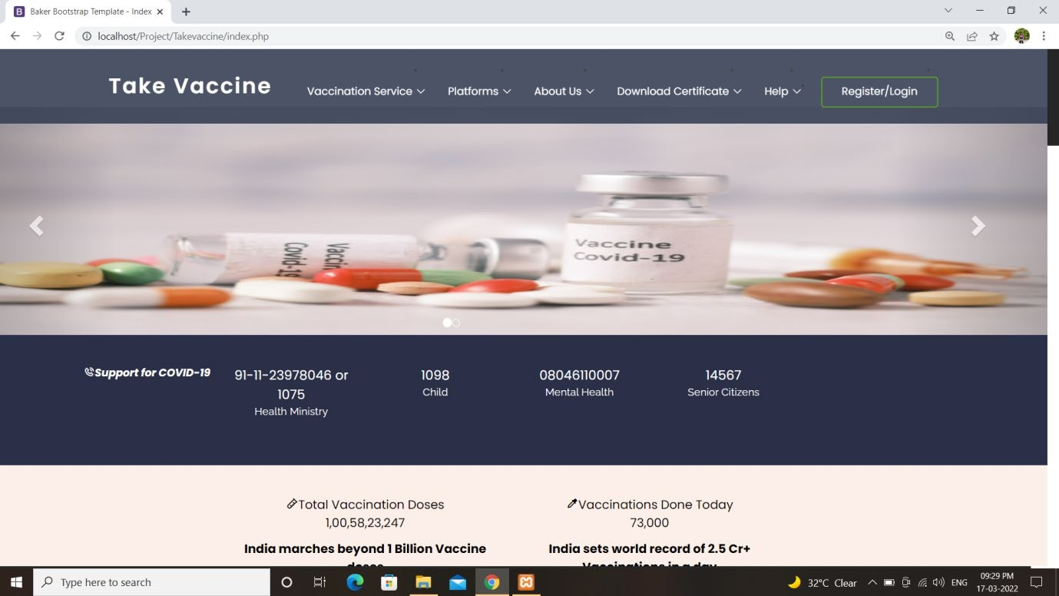
Snapshots
Home Page of the website where user can view the vaccination preview list. After then user has to go on Register/Login page to register there account.

Slide 17
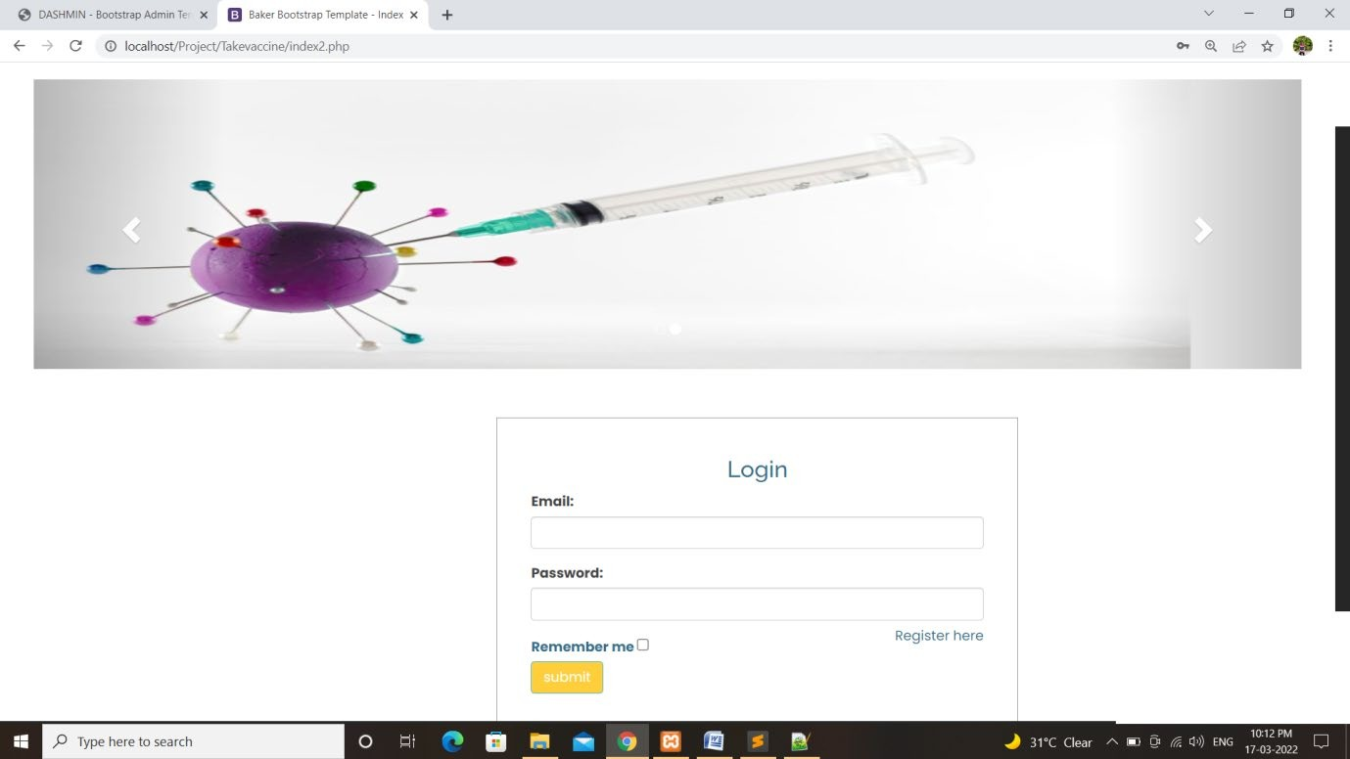
2) User can Login himself/herself for there account.

Slide 18
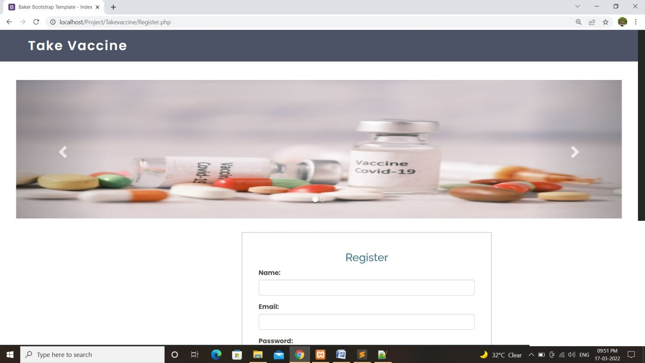
3) If user does not have his/her account then he can Register for there account.

Slide 19
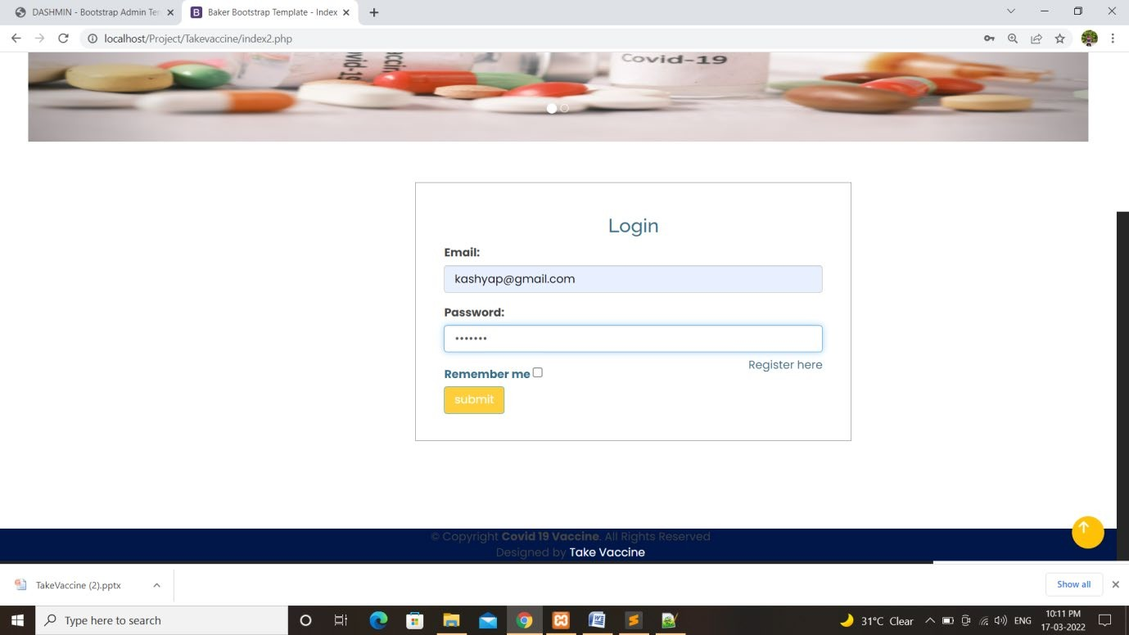
4) After Register user has to login his account and start with his process.

Slide 20
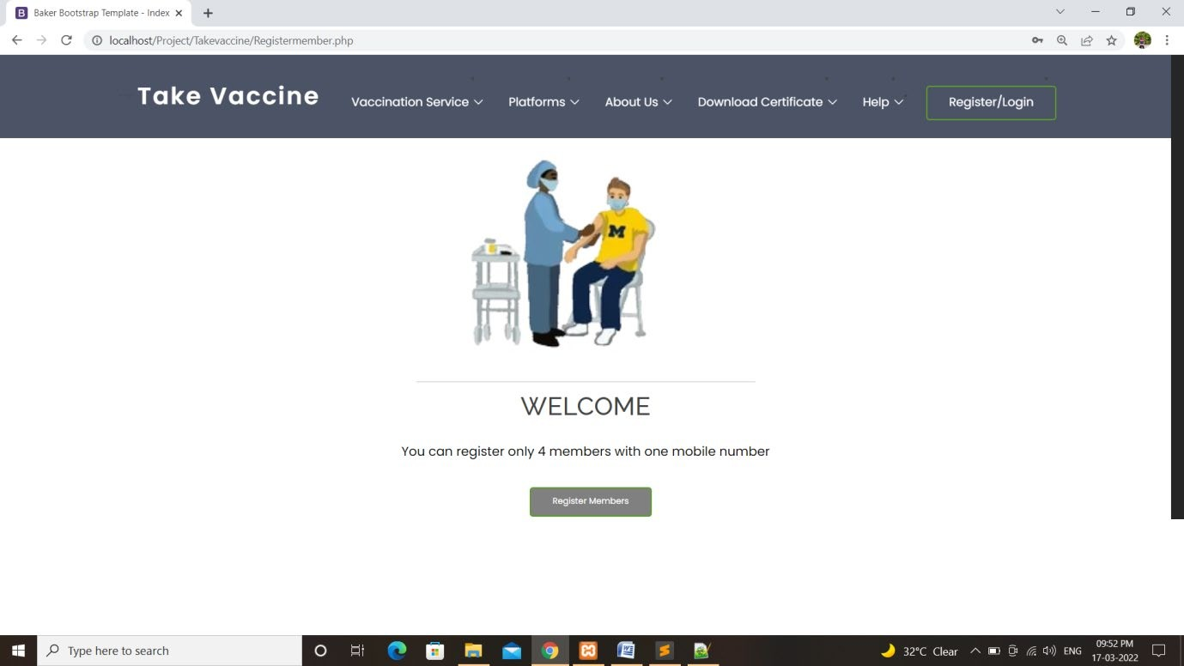
5) User has to click on Register Member Page for Vaccination Registration.

Slide 21
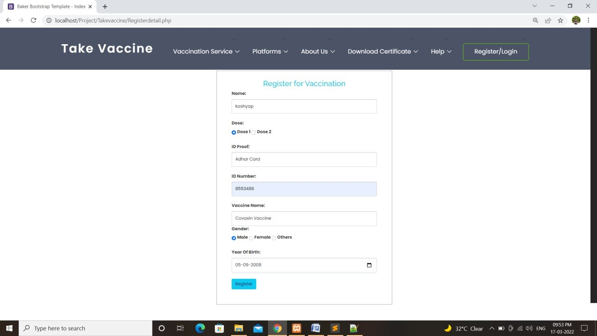
6) User has to fill the following fields for Registration of Vaccine.

Slide 22
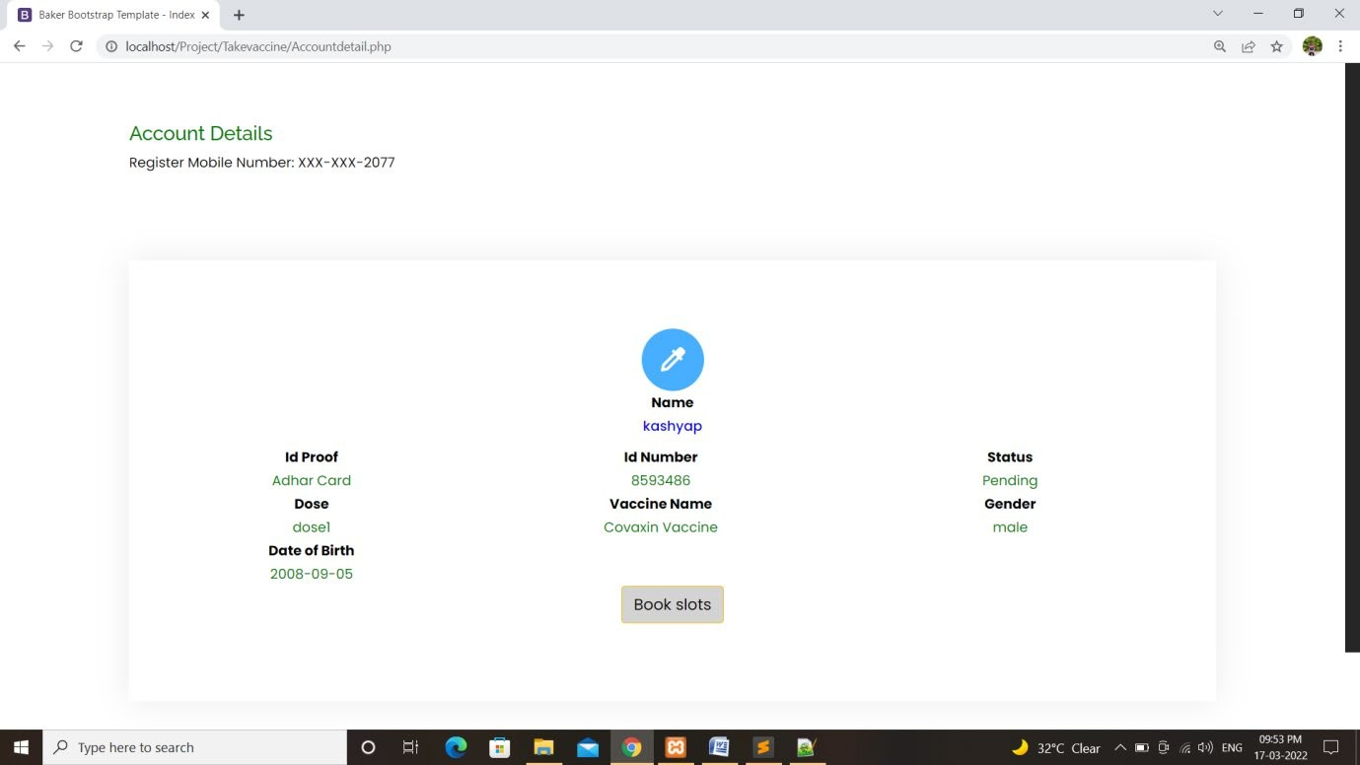
7) User can view his account detail and can go ahead for book slots.

Slide 23
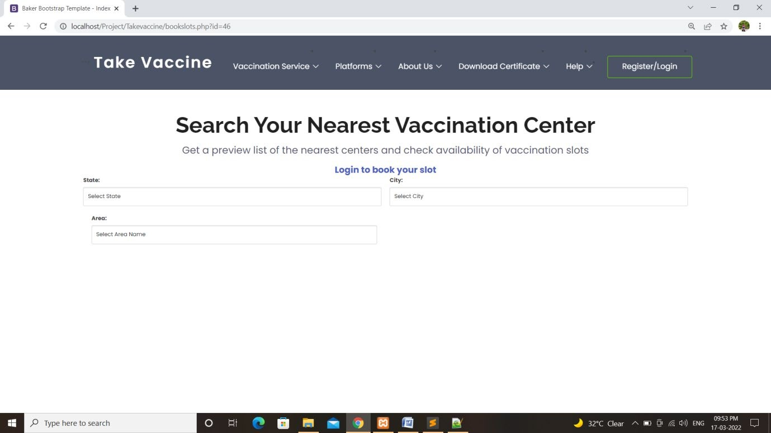
8) User can select his nearby available center by selecting state ,city, and area.

Slide 24
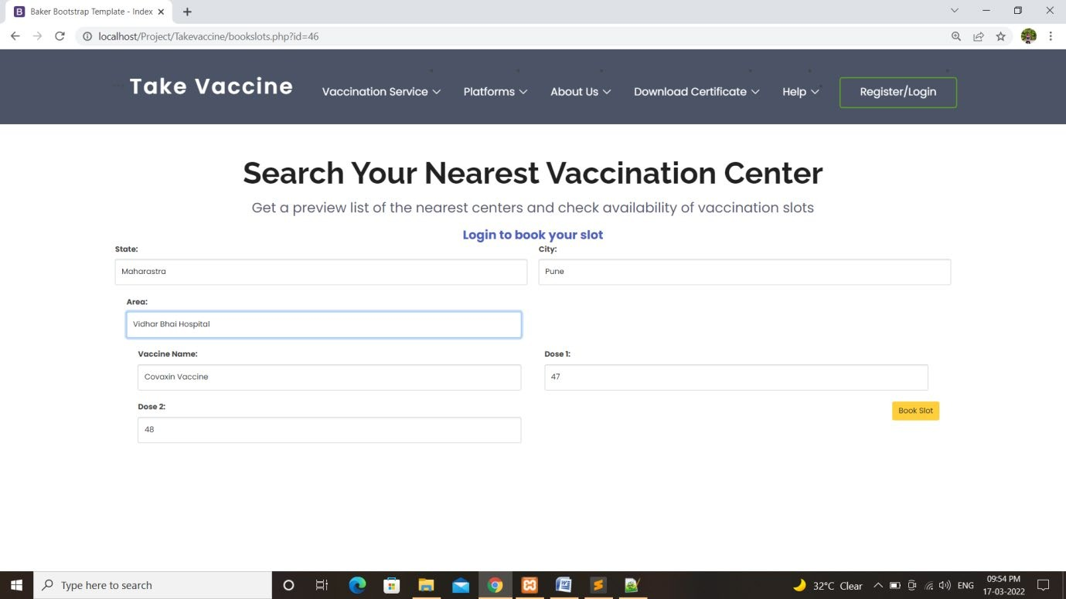
9) Like this user can select his center.

Slide 25
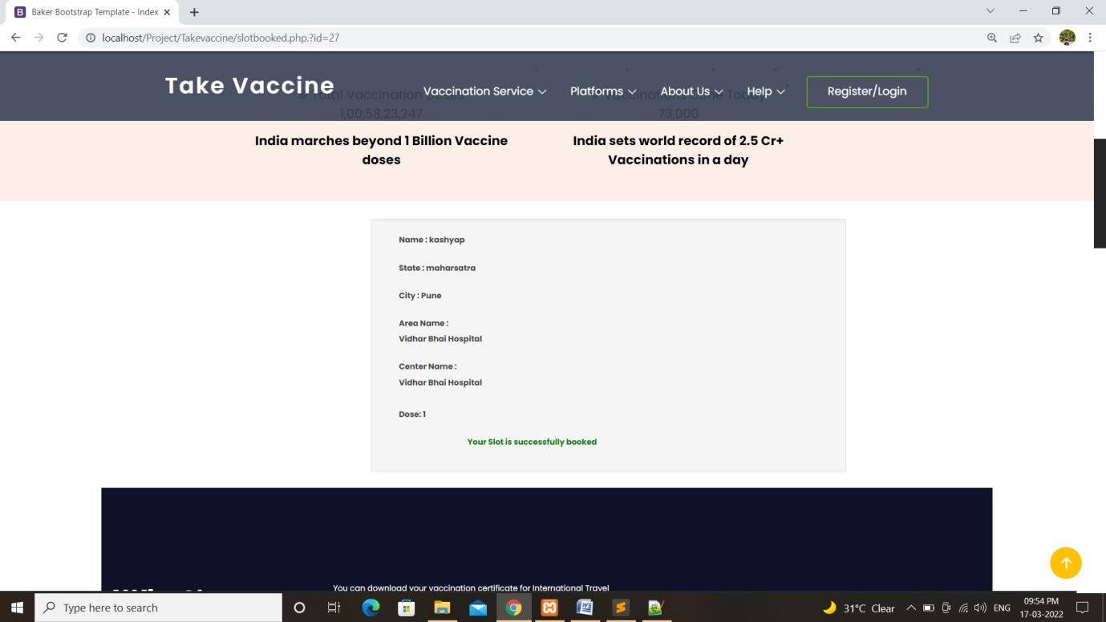
10) After selecting center user can get his slot detail and he/she can go and get his Vaccination .

Slide 26
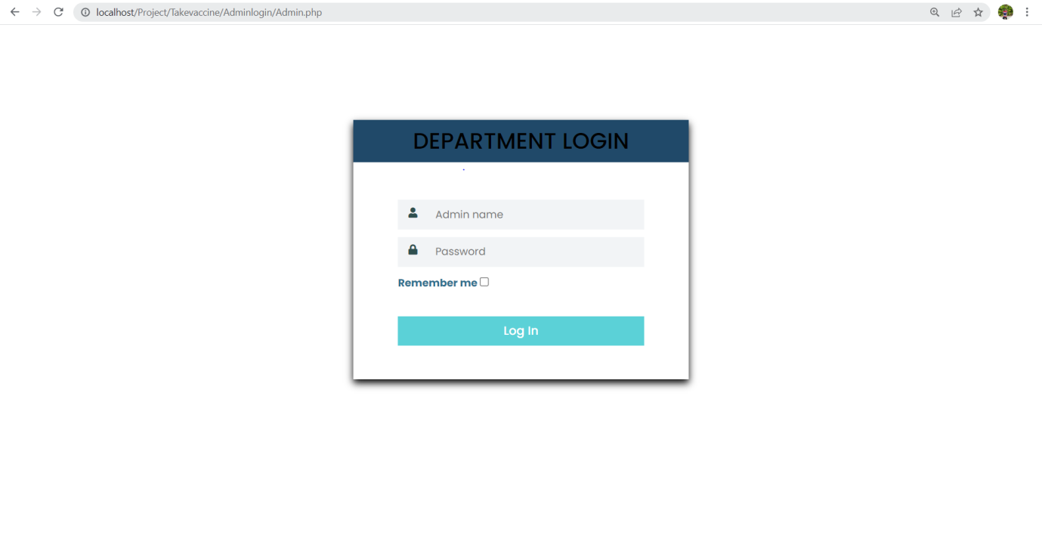
11) Admin has to login in his Admin Panel To view Users Activity.

Slide 27
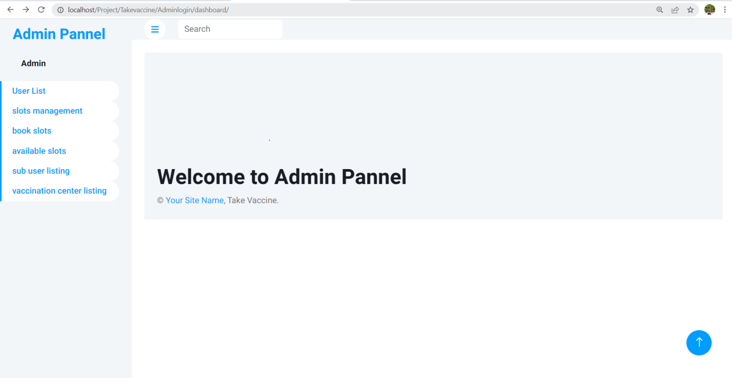
12) Admin can view Users Activity list.

Slide 28
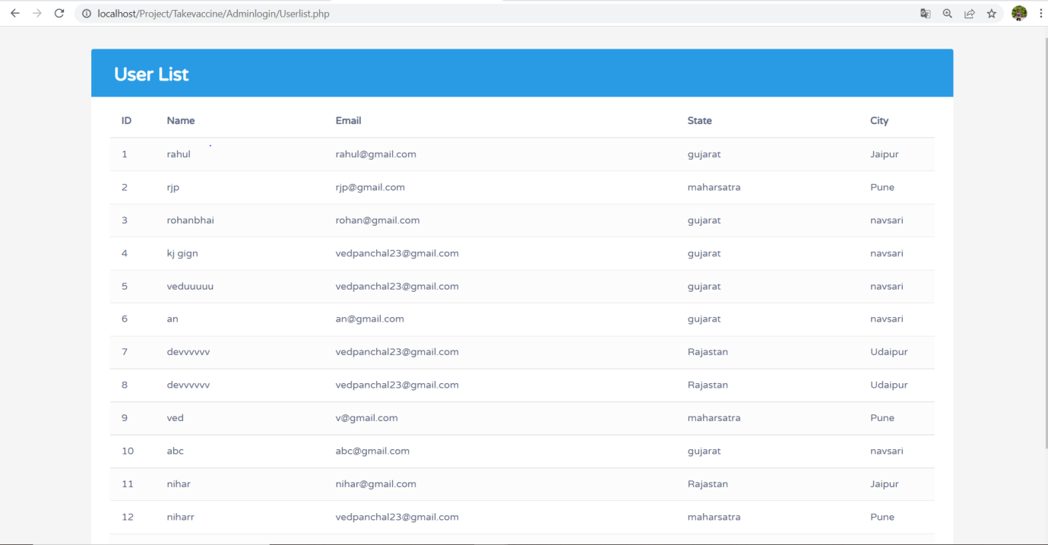
13) Admin can view all the users list.

Slide 29
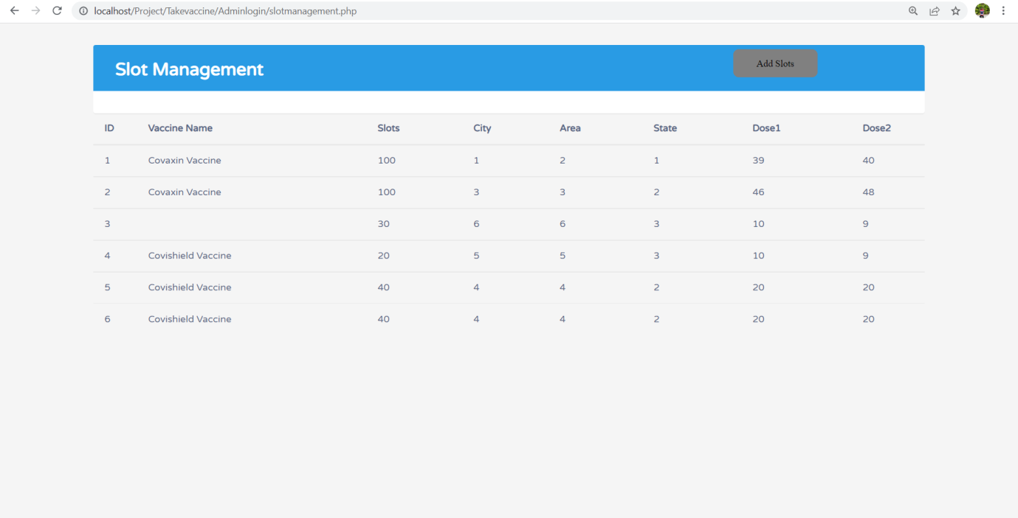
14) Admin can manage slots.

Slide 30
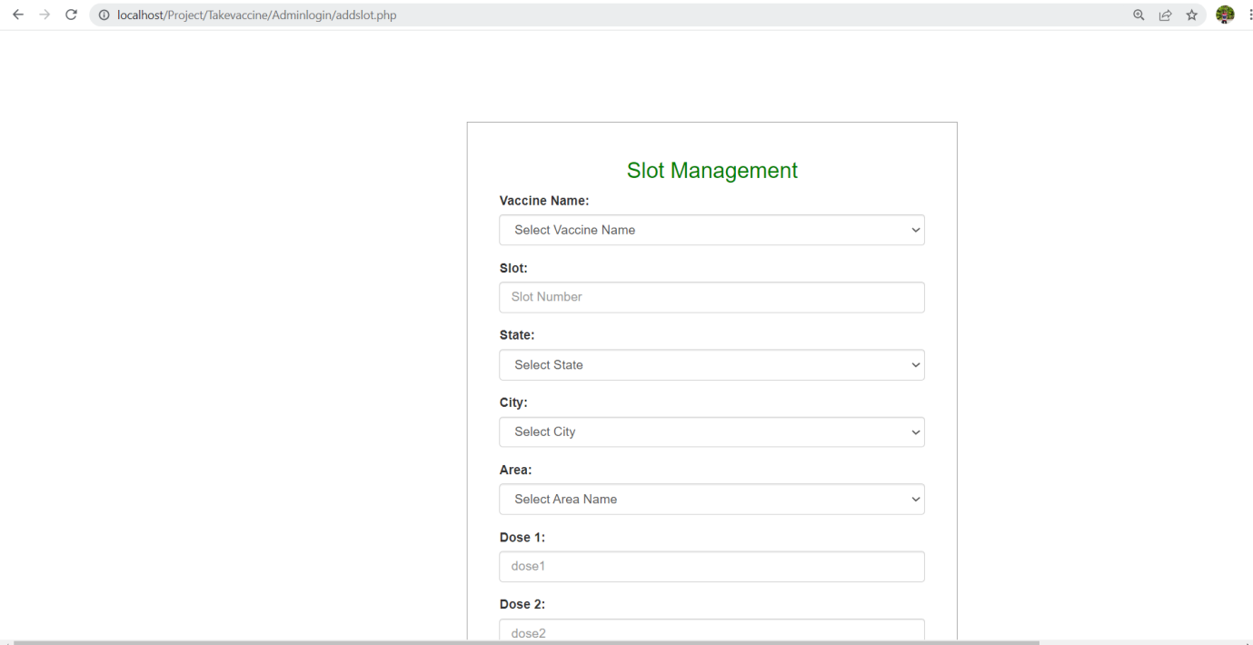
15) Admin can add slots if needed.

Slide 31
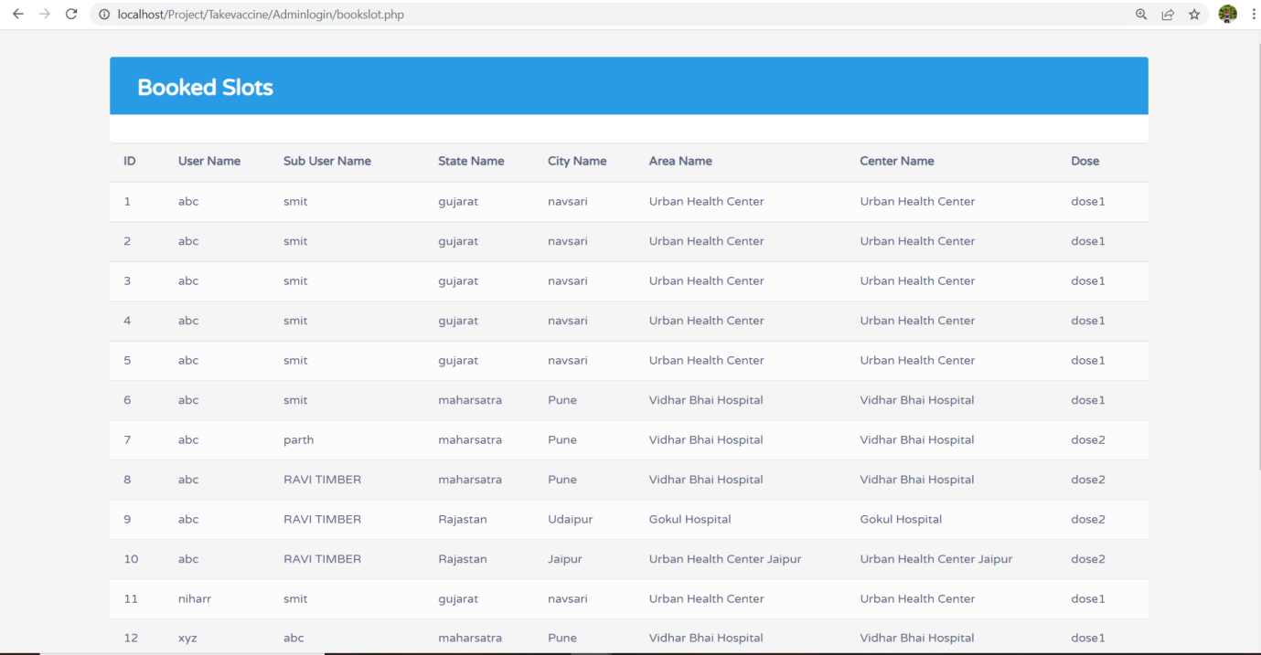
16) Admin can view all the booked slots.

Slide 32
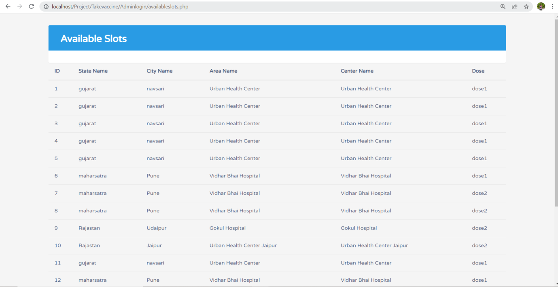
17) Admin can view the available slots.

Slide 33
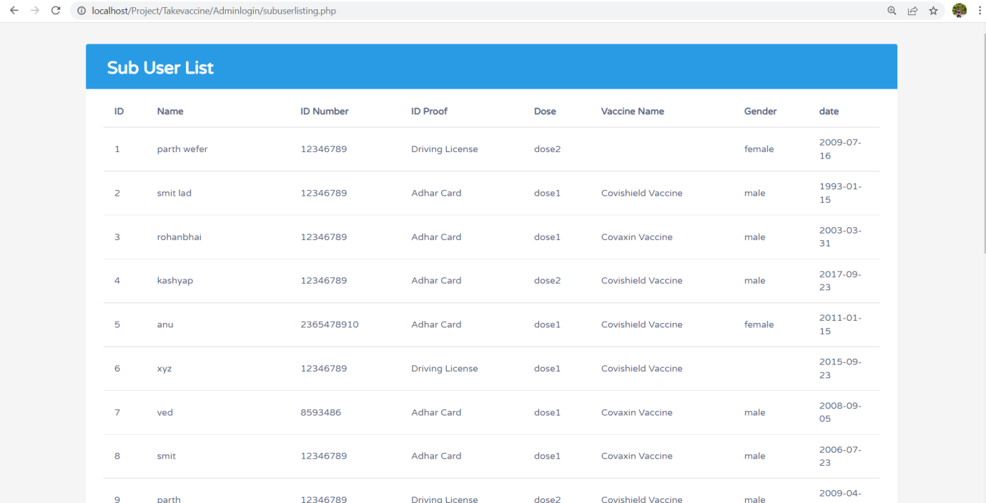
18) Admin can view all the Sub User list.

Slide 34
19) We can check number of users, Successful Registrations through Dashboard.

Slide 35
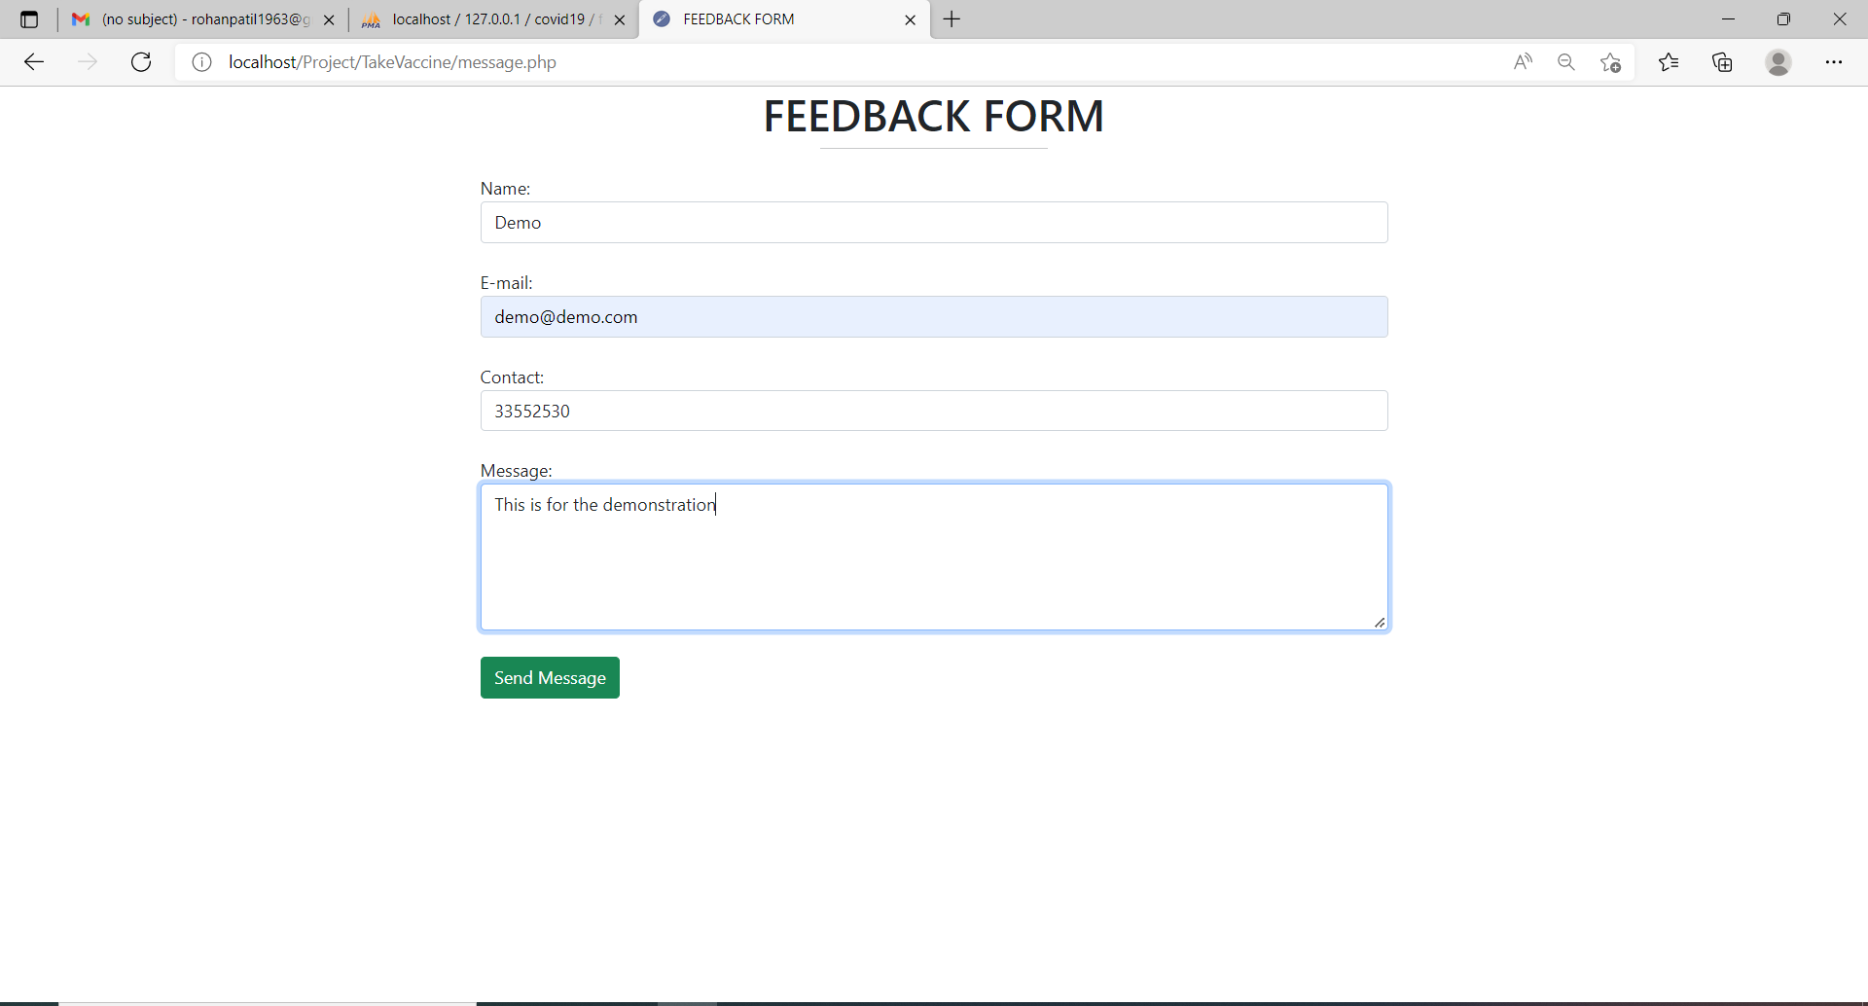
20) User can give the feedback.

Slide 36
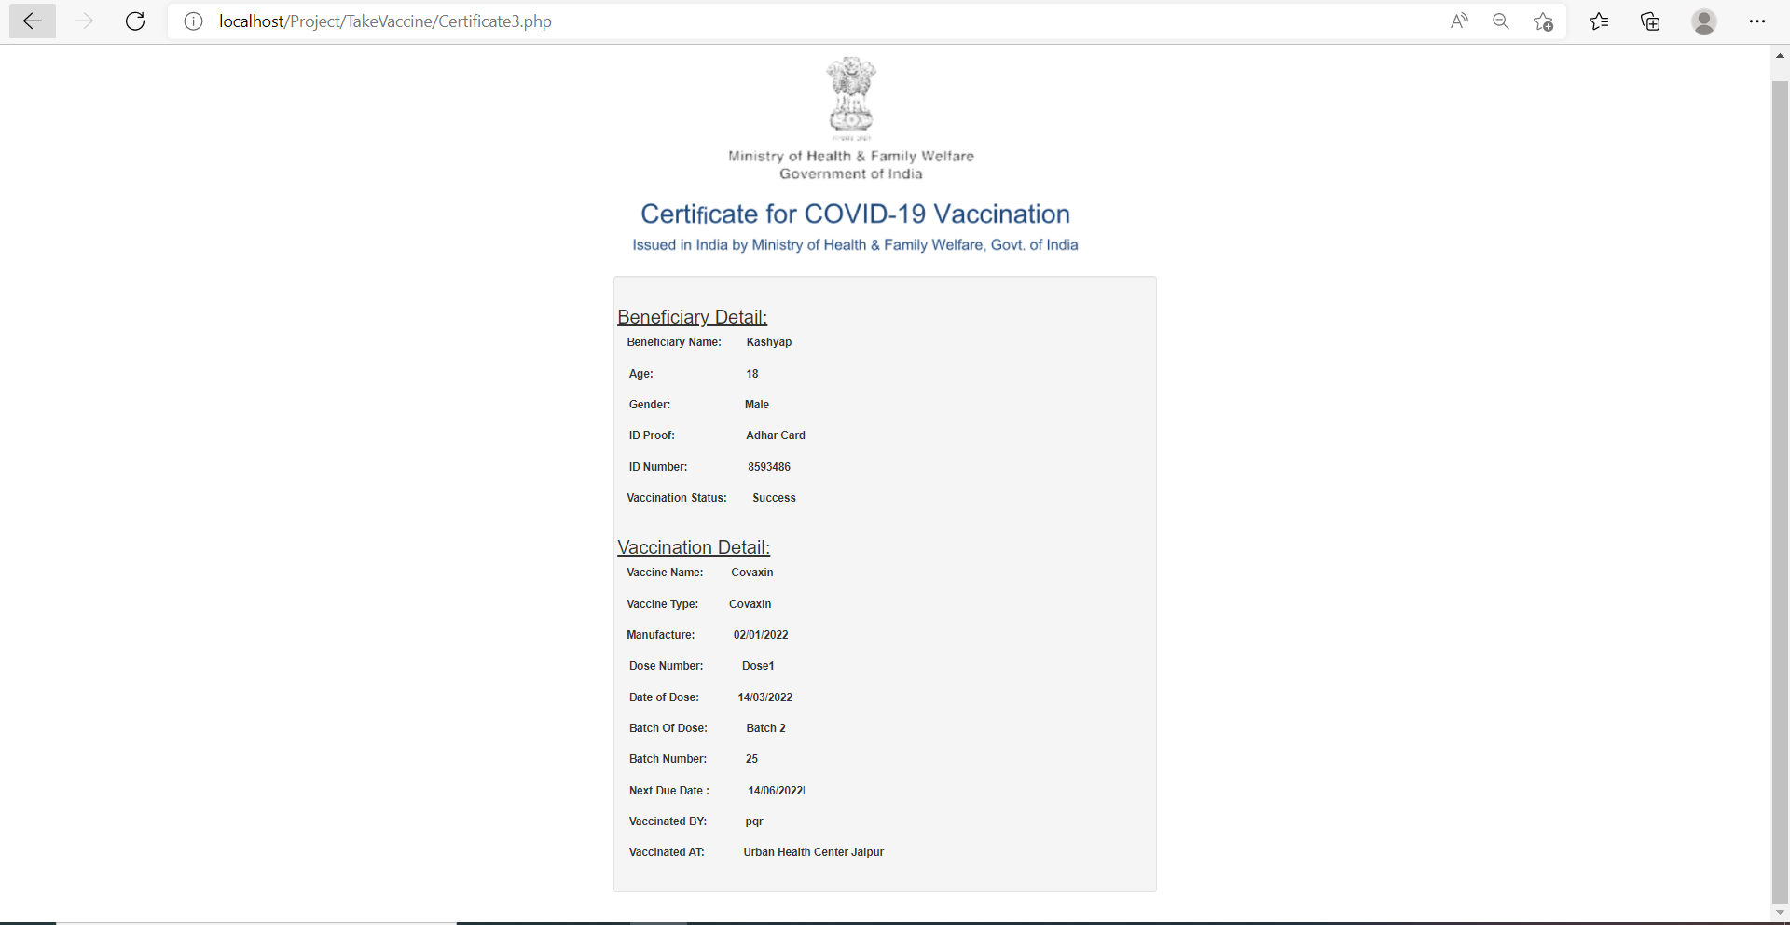
21) User will get certificate of vaccination

Slide 37
Advantages :
It Minimizes manual effort.
It is User friendly system.
Efficient track each vaccine until administered to a patient
Responsive system environment.

Slide 38
Disadvantages :
System portal facing too much traffic, can’t handle load.

Slide 39
Future Scope :
This website can be used to distribute vaccine in structured way.

Slide 40
Conclusion :
Vaccination management system has been developed as a digital platform to support Covid-19 vaccination efforts in India.
While most are familiar with the interface for citizens to book vaccination slots, system also supports multiple other functions. It is part of a sophisticated digital ecosystem, which monitors the vaccine supply chain, the vaccination staff and facilities, and records after-effects of immunisation.

Slide 41
Thank You

